Slide 1
Chapter 2
Motion in one dimension
2-1 Position, velocity, and speed
2-2 Instantaneous Velocity and Speed
2-4 Acceleration
2-6 Constant Acceleration
2-7 Free-Fall Acceleration

Slide 2
2-1 Position, velocity, and speed
Position
Motion along a straight line ≡ One-dimensional motion
Vertical
Horizontal
Slanted
Particle
Object
An object moves like a particle if every portion of the object moves in the same direction and at the same rate.
Object is located at x = -4 m
Object is located at x = 3 m
x (m)
-4
-3
-2
-1
0
1
2
3
4
Origin

Slide 3
2-1 Position, velocity, and speed
Position-time graph
x (m)
2
1
Stationary particle
t (s)
0
1
2
3
4
x (m)
-1
-2
-1
0
1
2
-2
x (m)
x (m)
t = 0 s
-2
-1
0
1
2
2
t = 1 s
x (m)
1
-2
-1
0
1
2
t = 2 s
x (m)
t (s)
-2
-1
0
1
2
0
1
2
3
4
-1
t = 3 s
x (m)
-2
-1
0
1
2
-2
t = 4 s
x (m)
-2
-1
0
1
2

Slide 4
2-1 Position, velocity, and speed
Displacement
Displacement = final position - initial position
 Δx = x_{f} -x_{i}
Δ = uppercase Greek letter delta
Δ ≡ change
Δx ≡ change in x
Initial position
x_{i}
Final position
x_{f}
x (m)
-2
-1
0
1
2
Displacement in the positive direction is positive.
x_{i}
x_{f}
x_{i}
x_{f}
x (m)
x (m)
-2
-1
0
1
2
-4
-3
-2
-1
0
Δx = 1 - (-2) = 3 m
Δx = -1 - (-4) = 3 m
Displacement in the negative direction is negative.
x_{f}
x_{i}
x_{f}
x_{i}
x (m)
x (m)
-2
-1
0
1
2
-4
-3
-2
-1
0
Δx = -2- 1 = -3 m
Δx = -4- (-1) = -3 m

Slide 5
2-1 Position, velocity, and speed
Displacement is a vector quantity
x_{i}
x_{f}
x (m)
Displacement Δx = 3 m means the object position has changed by 3 m in the positive direction.
-2
-1
0
1
2
Δx = 3 m
x_{f}
x_{i}
Displacement Δx = - 3 m means the object position has changed by 3 m in the negative direction.
x (m)
-2
-1
0
1
2
Δx = -3 m
To determine the displacement of an object, you need to specify
1- Magnitude (The distance between the initial and final positions. Always positive)
2- Direction (Negative or positive direction)
→ Displacement is a vector quantity.
Magnitude (Absolute value). Always positive.
Δx = - 3 m
Direction.

Slide 6
2-1 Position, velocity, and speed
Total distance
x_{i}
x_{f}
Δx = 1 m.
Total distance = 7 m.
x (m)
-2
-1
0
1
2
Total distance is not always equal to the magnitude of displacement.
x_{f}
x_{i}
Δx = - 1 m.
Total distance = 7 m.
x (m)
-2
-1
0
1
2
Total distance is always positive and does not depend on the direction.
→ Total distance is a scalar quantity.
x_{i}
x_{f}
Δx = 1 m.
Total distance = 1 m.
x (m)
-2
-1
0
1
2
Displacement depends only on the initial and final positions.
Total distance depends on the path.

Slide 7
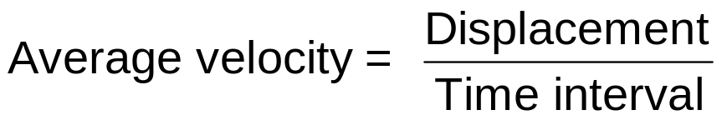
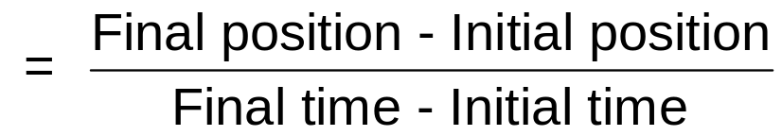
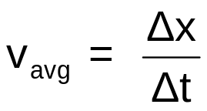
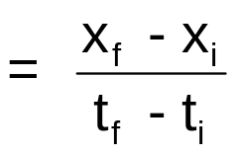

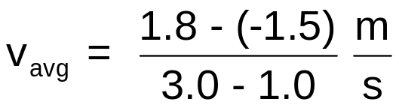
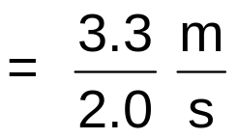
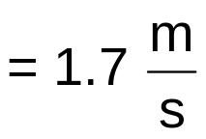
2-1 Position, velocity, and speed
Average velocity
The average velocity v_{avg} for a time interval is
Since Δt is always positive, average velocity has the same sign as the displacement .
SI unit for average velocity is
x (m)
The average velocity for the time interval t = 1.0 s to t = 3.0 s is
2
1
t (s)
0
1
2
3
4
-1
-2

Slide 8




2-1 Position, velocity, and speed
Average velocity from x-t graph
x (m)
2
1
t (s)
0
1
2
3
4
-1
-2
On the x-t graph, the average velocity v_{avg} for a time interval is the slope of the straight line connecting the initial and final points.
The average velocity for the time interval t = 1.0 s to t = 3.0 s is

Slide 9
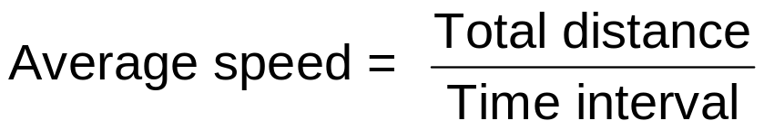
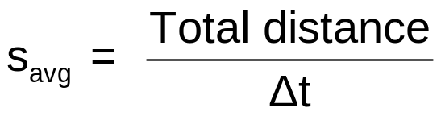
2-1 Position, velocity, and speed
Average speed
The average speed s_{avg} for a time interval is
Average speed is always positive. It does not include direction.
→ Average speed is a scalar quantity.

Slide 10



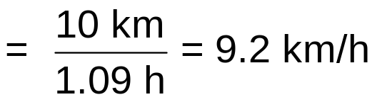





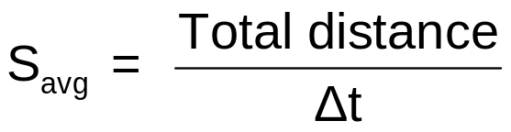
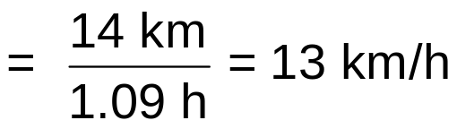
2-1 Position, velocity, and speed
Example
Trip along a straight line
Driving
10 km
0.17 h
Walking
2.0 km
0.42 h
Walking
0.50 h
What is your average velocity and average speed for the whole trip?
Solution
In the negative direction
Displacement

Slide 11


2-1 Position, velocity, and speed
Example 3
Trip along a straight line
Driving
10 km
0.17 h
Walking 1
2.0 km
0.42 h
Walking 2
0.50 h
Find the average velocity from the x-t graph.
Solution
x (km)
12
Walking 1
Walking 2
10
final
8
6
Driving
4
2
Initial
0
t (h)
0.2
0.4
0.6
0.8
1.0

Slide 12

2-1 Position, velocity, and speed
Checkpoint 2
Trip along a straight line
Driving
10. km
0.17 h
Walking
2.0 km
0.42 h
Driving
15 km/h
Walking
0.50 h
What is your average velocity?
Solution
Since the displacement is zero.

Slide 13
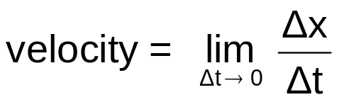
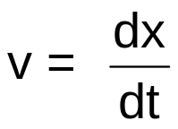

2-2 Instantaneous Velocity and Speed
Velocity
The instantaneous velocity v at a given instant is
velocity ≡ instantaneous velocity
Average velocity over a time period Δt
Velocity at an instant
x
x
Tangent line
t
t

Slide 14

2-2 Instantaneous Velocity and Speed
Speed
The speed at a given instant is the magnitude of the velocity.
v = - 4 m/s
→ speed = 4 m/s
v = 4 m/s
→ speed = 4 m/s
Speed is always positive. Speed is a scalar quantity.

Slide 15

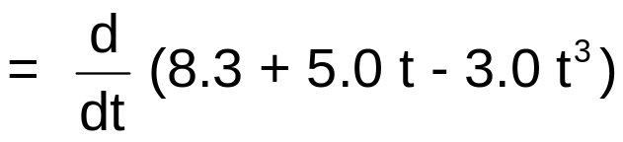




2-2 Instantaneous Velocity and Speed
Example 5
The position of a particle moving on an x axis is given by
with x in meters and t in seconds.
Find the velocity at t = 1.0 s.
Solution
At t = 1.0 s,
At t = 1.0 s, the particle is moving in the negative direction with a speed of 4.0 m/s.

Slide 16
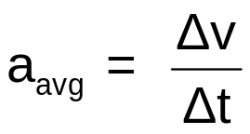
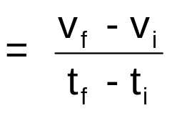
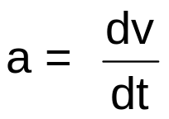
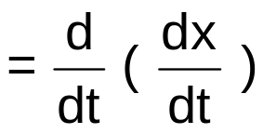
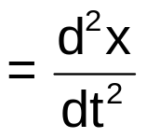

2-4 Acceleration
Definitions
The average acceleration a_{avg} over a time interval Δt is
The instantaneous acceleration a is
The acceleration of a particle is the derivative of its velocity with respect to time.
The acceleration of a particle is the rate at which its velocity is changing with time.
acceleration ≡ instantaneous acceleration
The acceleration of a particle is the second derivative of its position with respect to time.
SI unit for acceleration is

Slide 17
2-4 Acceleration
Checkpoint
What is the sign of acceleration?
Solution
moving
a
Increasing speed
Positive
moving
a
decreasing speed
Negative
moving
a
Increasing speed
Negative
moving
a
decreasing speed
Positive

Slide 18

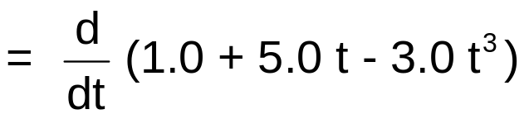
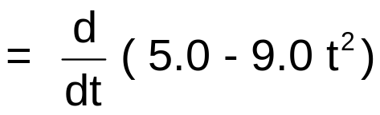


2-4 Acceleration
Example 6
The position of a particle moving on an the x axis is given by
with x in meters and t in seconds.
Find the acceleration of the particle as a function of time.
Solution

Slide 19

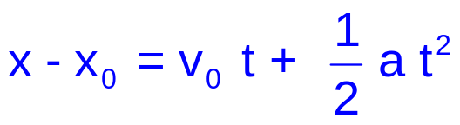

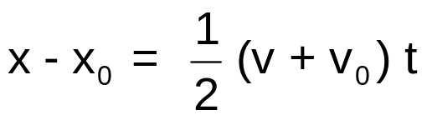
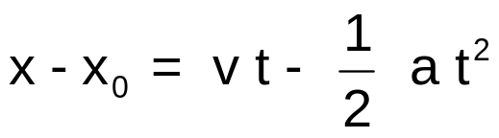
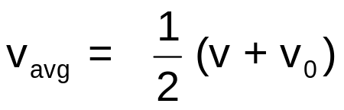
2-5 Constant Acceleration
Formulas
Equations for motion with constant acceleration
Valid only for a = constant
Basic equations
Notations
t_{i} → 0
t_{f} → t
x_{i} → x₀
x_{f} → x
v_{i} → v₀
v_{f} → v
Useful and can be derived from the two basic equations

Slide 20
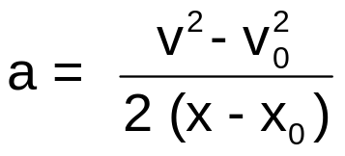
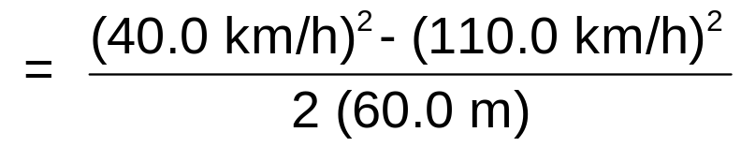
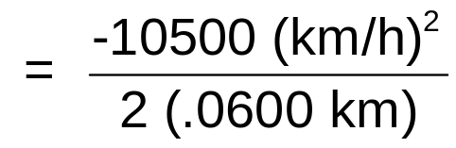

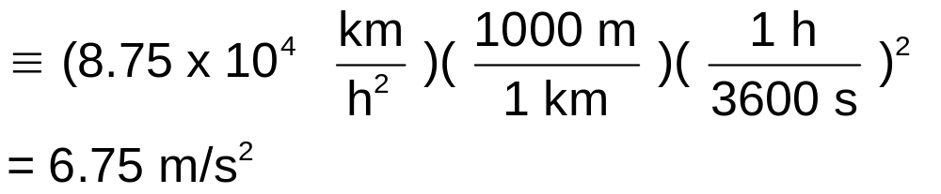

2-5 Constant Acceleration
Example 7
Braking at a constant acceleration.
60.0 m
110 km/h
40.0 km/h
What is the acceleration in m/s²?
Solution
Since we know the displacement x - x₀,the initial velocity v₀, and the final velocity v, we can use the following equation to find a

Slide 21
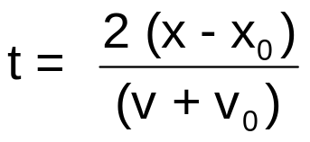
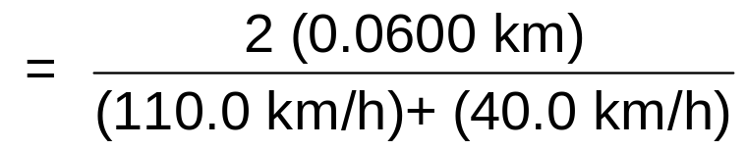

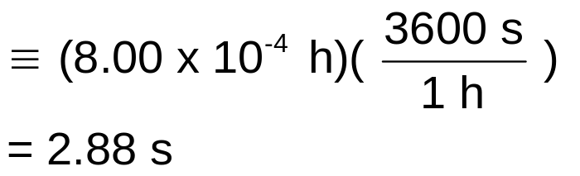

2-5 Constant Acceleration
Example 8
Braking at a constant acceleration.
60.0 m
110 km/h
40.0 km/h
What is the time in seconds?
Solution
Since we know the displacement x - x₀,the initial velocity v₀, and the final velocity v, we can use the following equation to find t

Slide 22


2-6 Free-Fall Acceleration
Free-fall
In the absence of the effects of air, all objects dropped or thrown near Earth's surface have a certain constant acceleration toward Earth. This acceleration is called free-fall acceleration and it is due to Earth's gravity.
y
positive direction
constant
free-fall acceleration
g is the magnitude of the free-fall acceleration.
g is always positive.
g = 9.8 m/s².
Earth's surface
The value of g varies slightly from place to place on Earth's surface. the value g = 9.8 m/s² is accurate enough for our purposes in this course.

Slide 23

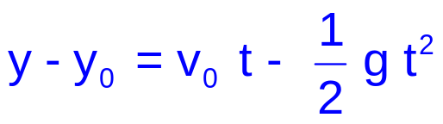


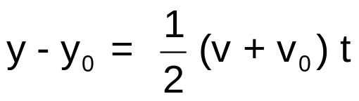
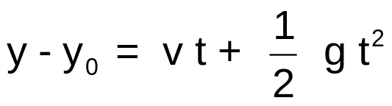
2-6 Free-Fall Acceleration
Formulas
Equations for free-fall = Equations for motion with constant acceleration
x → y
x₀ → y₀
a → - g
Basic equations
y
positive direction
Useful and can be derived from the two basic equations
Earth's surface

Slide 24
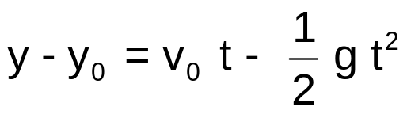

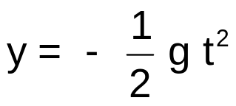
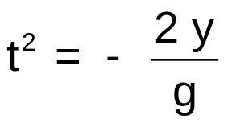
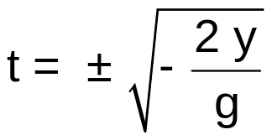
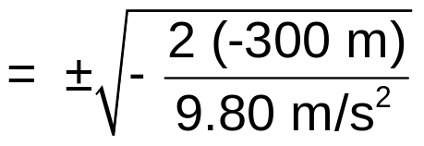


2-6 Free-Fall Acceleration
Example 9
Solution
y
Since we know y - y₀ and v₀, we can use the following equation to find t
Cliff
initially at rest
0
Choose the origin of the y-axis at the cliff.
Initially at rest
300. m
Ground
-300 m
Since the ball reaches the ground after t = 0, the negative answer is not valid.
How long does the ball fall to reach the ground?

Slide 25



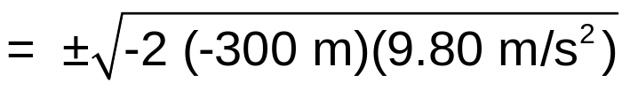


2-6 Free-Fall Acceleration
Example 10
Solution
y
Since we know y - y₀ and v₀, we can use the following equation to find v
Cliff
initially at rest
0
Choose the origin of the y-axis at the cliff.
Initially at rest
300. m
Since the ball is moving in the negative direction, the positive answer is not valid.
Ground
-300 m
What is the ball velocity when it hits the ground?

Slide 26


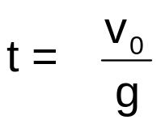
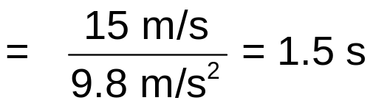
2-6 Free-Fall Acceleration
Example 11
Solution
Since we know v and v₀, we can use the following equation to find t
At its maximum height, the ball is at rest → v = 0
Thrown up with initial velocity 15 m/s.
How long does the ball take to reach its maximum height?

Slide 27
2-6 Free-Fall Acceleration
Checkpoint 6
Solution
What is the sign of the ball displacement for the ascent, from the release point to the highest point?
Positive
What is the sign of the ball displacement for the descent, from the highest point back to the release point?
Negative
What is the ball's acceleration at its highest point?
a = - g = -9.8 m/s²

